Slide 1

Chapter 27
IPv6
Protocol
Copyright © The McGraw-Hill Companies, Inc. Permission required for reproduction or display.

Slide 2
OBJECTIVES:
To give the format of an IPv6 datagram composed of a base header and a payload.
To discuss different fields used in an IPv6 datagram based header and compare them with the fields in IPv4 datagram.
To show how the options in IPv4 header are implemented using the extension header in IPv6.
To show how security is implemented in IPv6.
To discuss three strategies used to handle the transition from IPv4 to IPv6: dual stack, tunneling, and header translation.

Slide 3
Chapter
Outline
27.1 Introduction
27.2 Packet Format
27.3 Transition to IPv6

Slide 4
27-1 INTRODUCTION
In this introductory section, we discuss two topics: rationale for a new protocol and the reasons for delayed adoption.

Slide 5
Topics Discussed in the Section
Rationale for Change
Reason for Delay in Adoption

Slide 6
27-2 PACKET FORMAT
The IPv6 packet is shown in Figure 27.1. Each packet is composed of a mandatory base header followed by the payload. The payload consists of two parts: optional extension headers and data from an upper layer. The base header occupies 40 bytes, whereas the extension headers and data from the upper layer contain up to 65,535 bytes of information.

Slide 7
Topics Discussed in the Section
Base Header
Flow Label
Comparison between IPv4 and IPv6 Headers
Extension Headers
Comparison between IPv4 and IPv6 Options

Slide 8
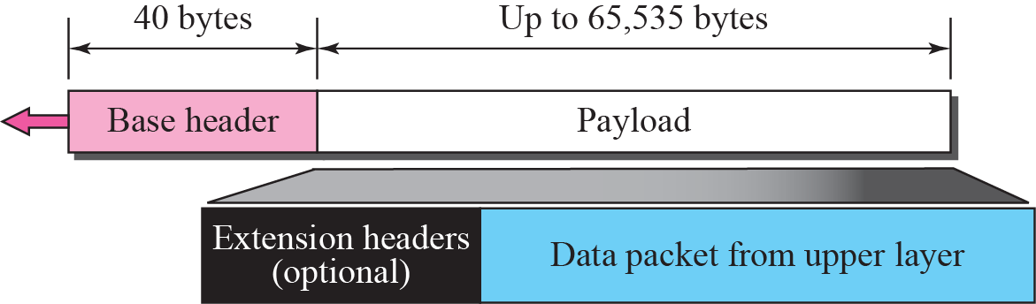
Figure 27.1 IPv6 datagram

Slide 9
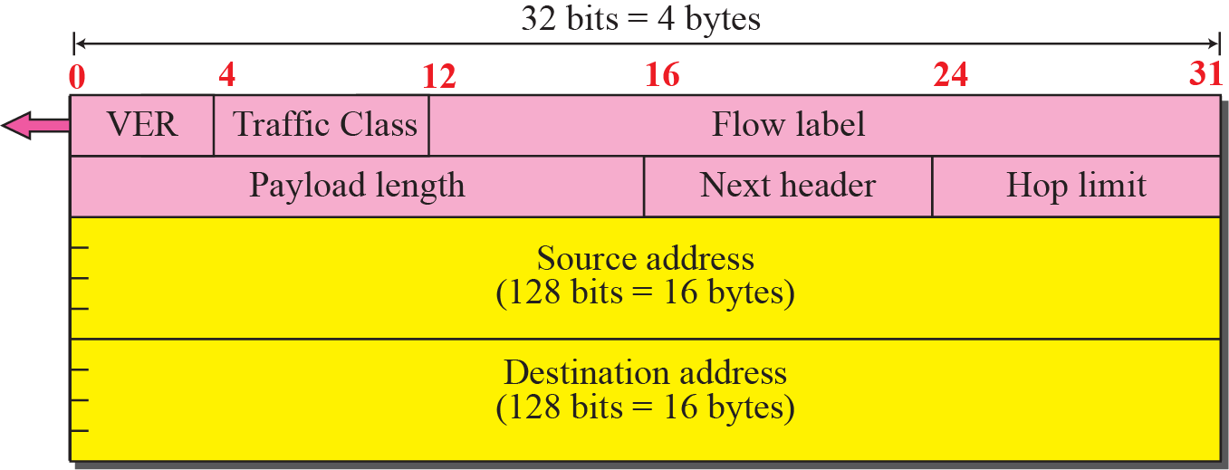
Figure 27.2 Format of the base header

Slide 10
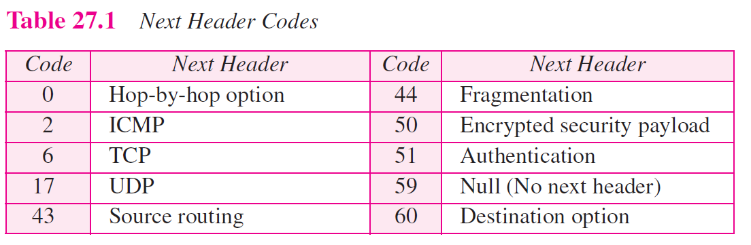

Slide 11
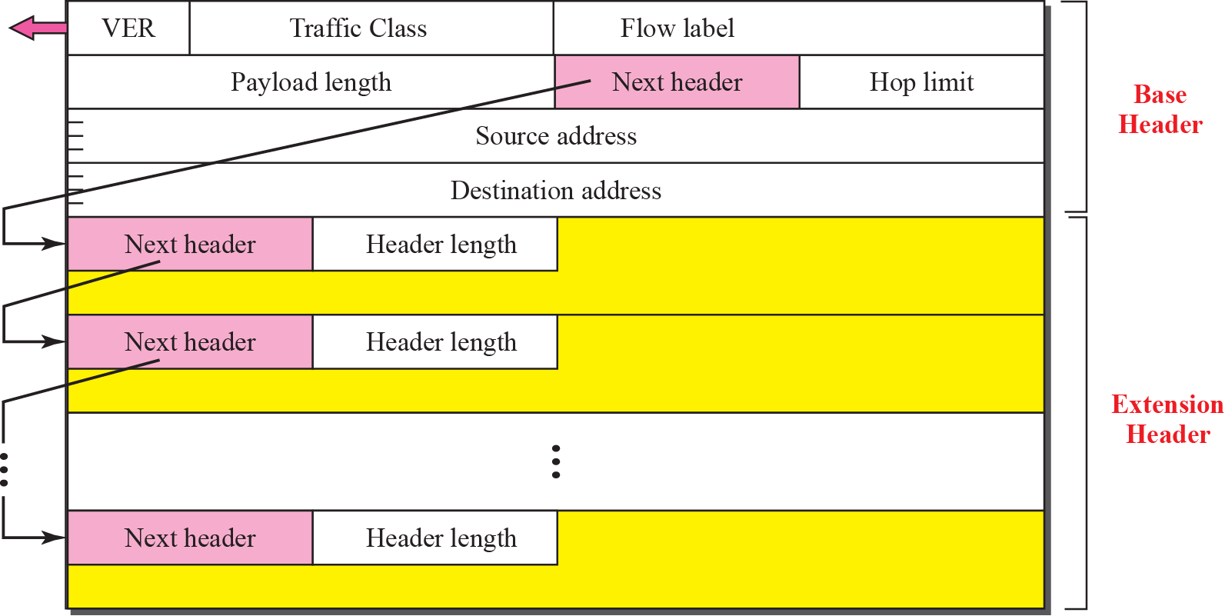
Figure 27.3 Extension header format

Slide 12
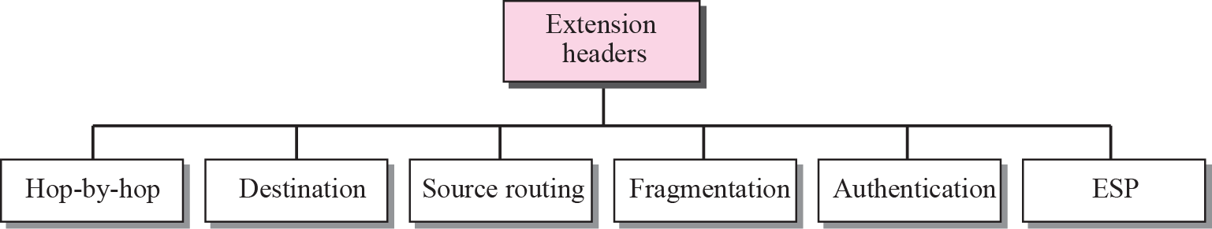
Figure 27.4 Extension header types

Slide 13
Figure 27.5 Hop-by-hop option header format

Slide 14
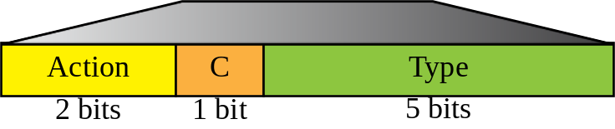

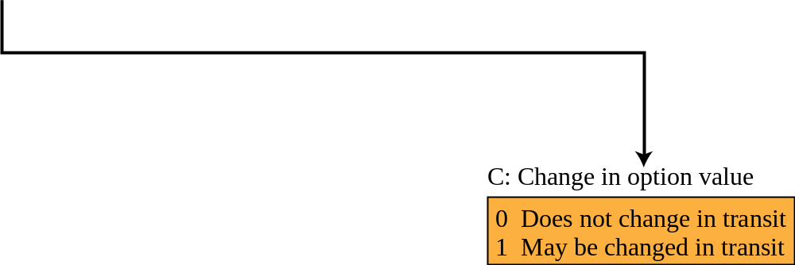
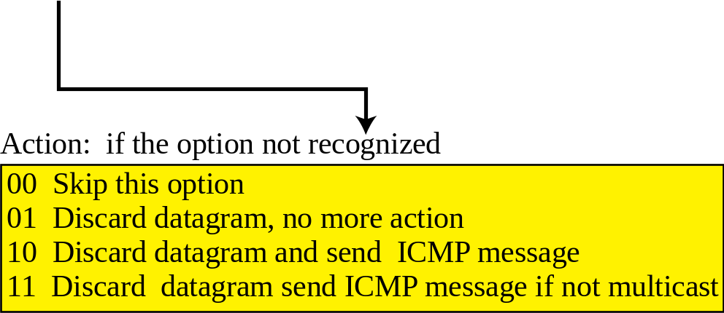
Figure 27.6 The format of the option in a hop-by-hop option header

Slide 15
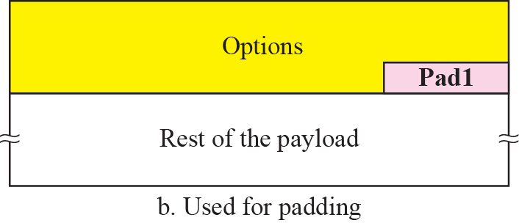
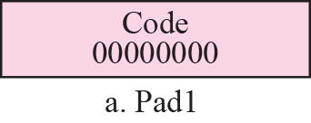
Figure 27.7 Pad1

Slide 16
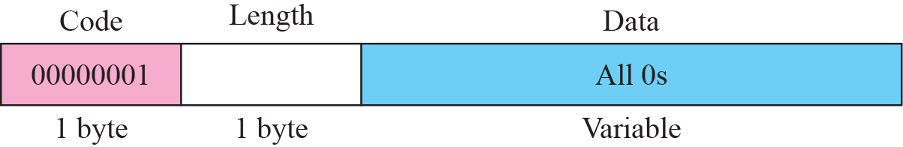
Figure 27.8 PadN

Slide 17
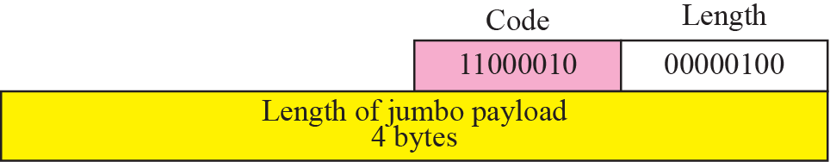
Figure 27.9 Jumbo payload

Slide 18
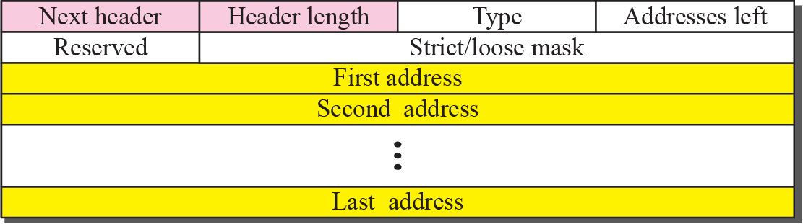
Figure 27.10 Source routing

Slide 19
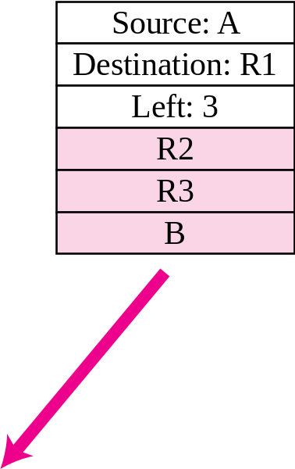
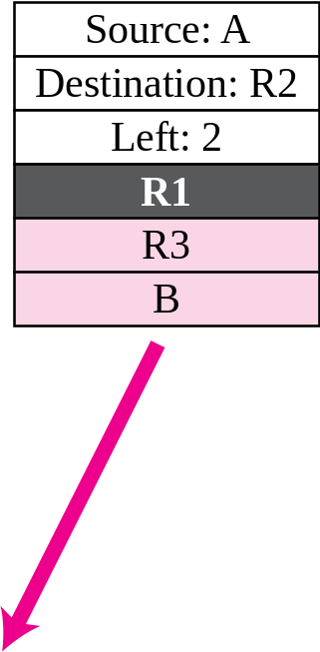
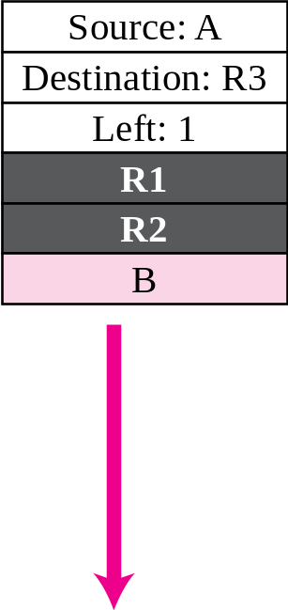
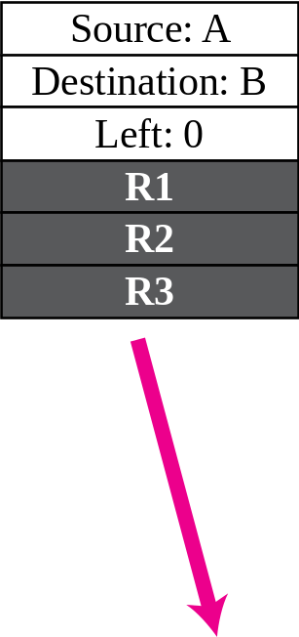
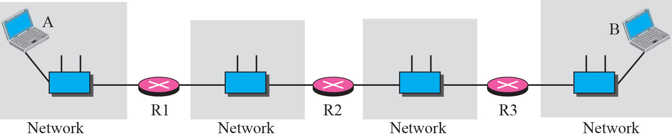
Figure 27.11 Source routing example

Slide 20
Figure 27.12 Fragmentation

Slide 21

Figure 27.13 Authentication

Slide 22
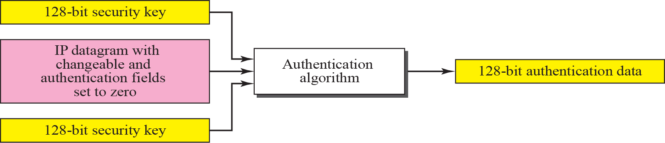
Figure 27.14 Calculation of authentication data

Slide 23
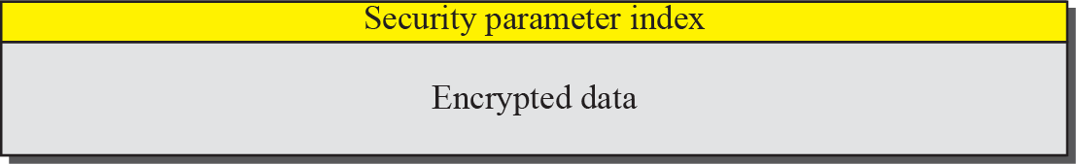
Figure 27.15 Encrypted security payload

Slide 24
27-3 TRANSITION FROM IPv4 TO IPv6
Because of the huge number of systems on the Internet, the transition from IPv4 to IPv6 cannot happen suddenly. It will take a considerable amount of time before every system in the Internet can move from IPv4 to IPv6. The transition must be smooth to prevent any problems between IPv4 and IPv6 systems. Three strategies have been devised by the IETF to help the transition (see Figure 27.16).

Slide 25
Topics Discussed in the Section
Dual Stack
Tunneling
Header Translation

Slide 26
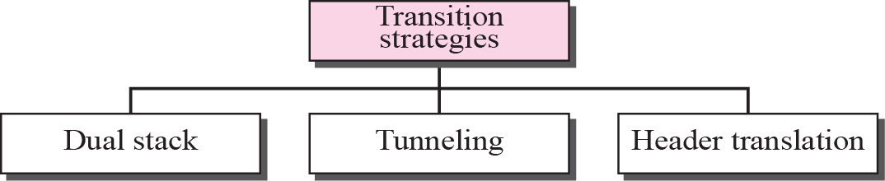
Figure 27.16 Three transition strategies

Slide 27
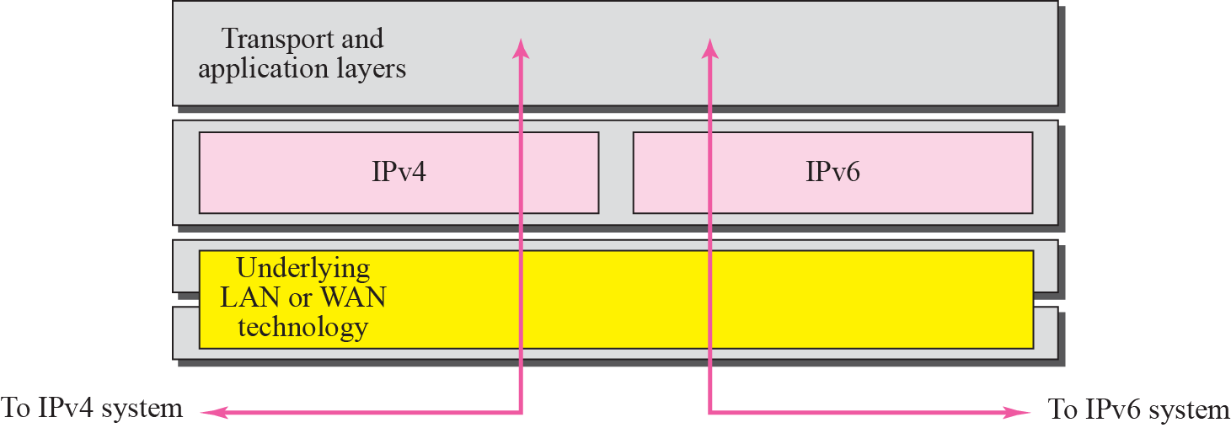
Figure 27.17 Dual stack

Slide 28
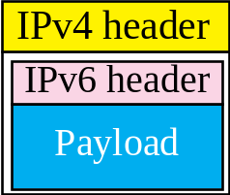
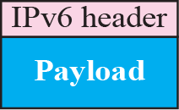
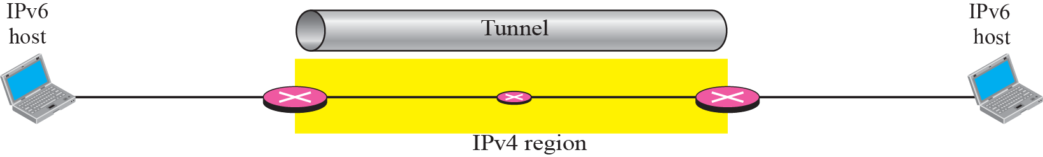
Figure 27.18 Tunneling strategy

Slide 29
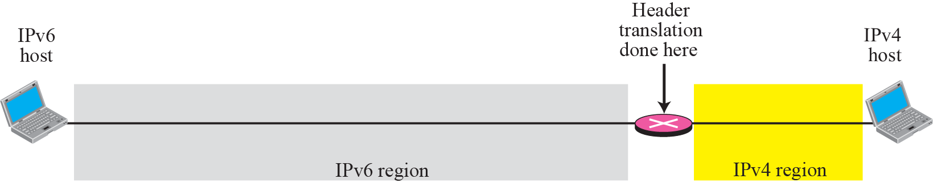
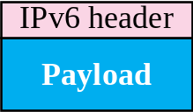
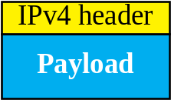
Figure 27.19 Header translation strategy

